Slide 1
Guatemala Case
Pack 1– Visit to the Cooperative

Slide 2
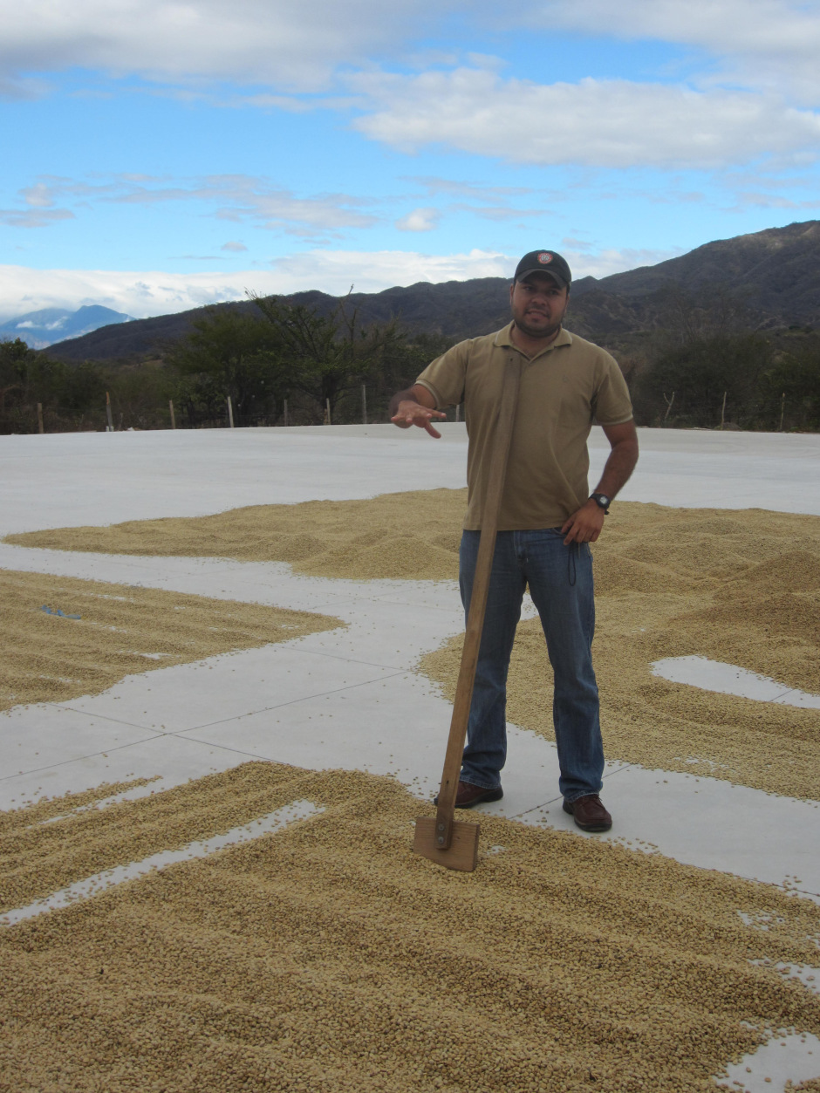
Drying Patio
The manager showing us where they dry the coffee beans from the farmers
The “gold” coffee beans must be dried before they are ready for processing
Large concrete patio just in back of the co-op building

Slide 3
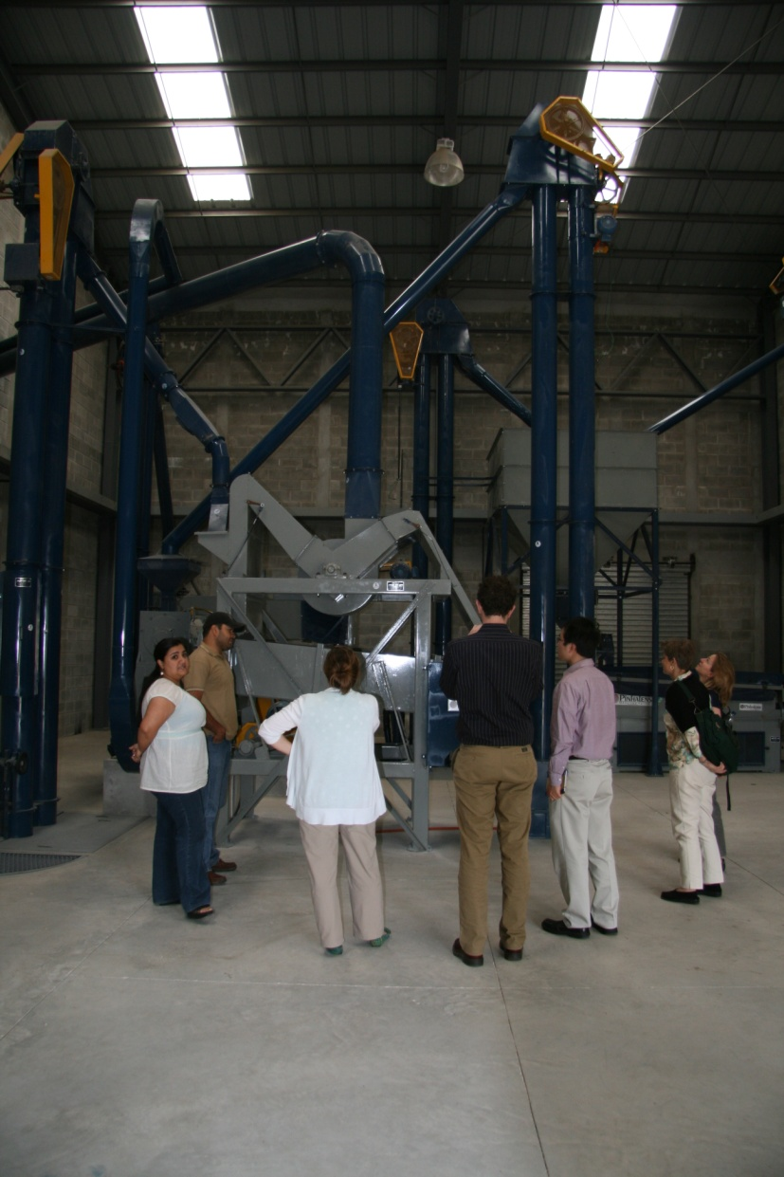
Dry Mill
Shiny new dry mill – gift from bishop’s friends in Italy
Currently operates 2/wk. year
Extra labor required during processing
Others in the area have approached the cooperative about processing their beans in the dry mill
Possibly Insert Dry-mill economics here…..

Slide 4
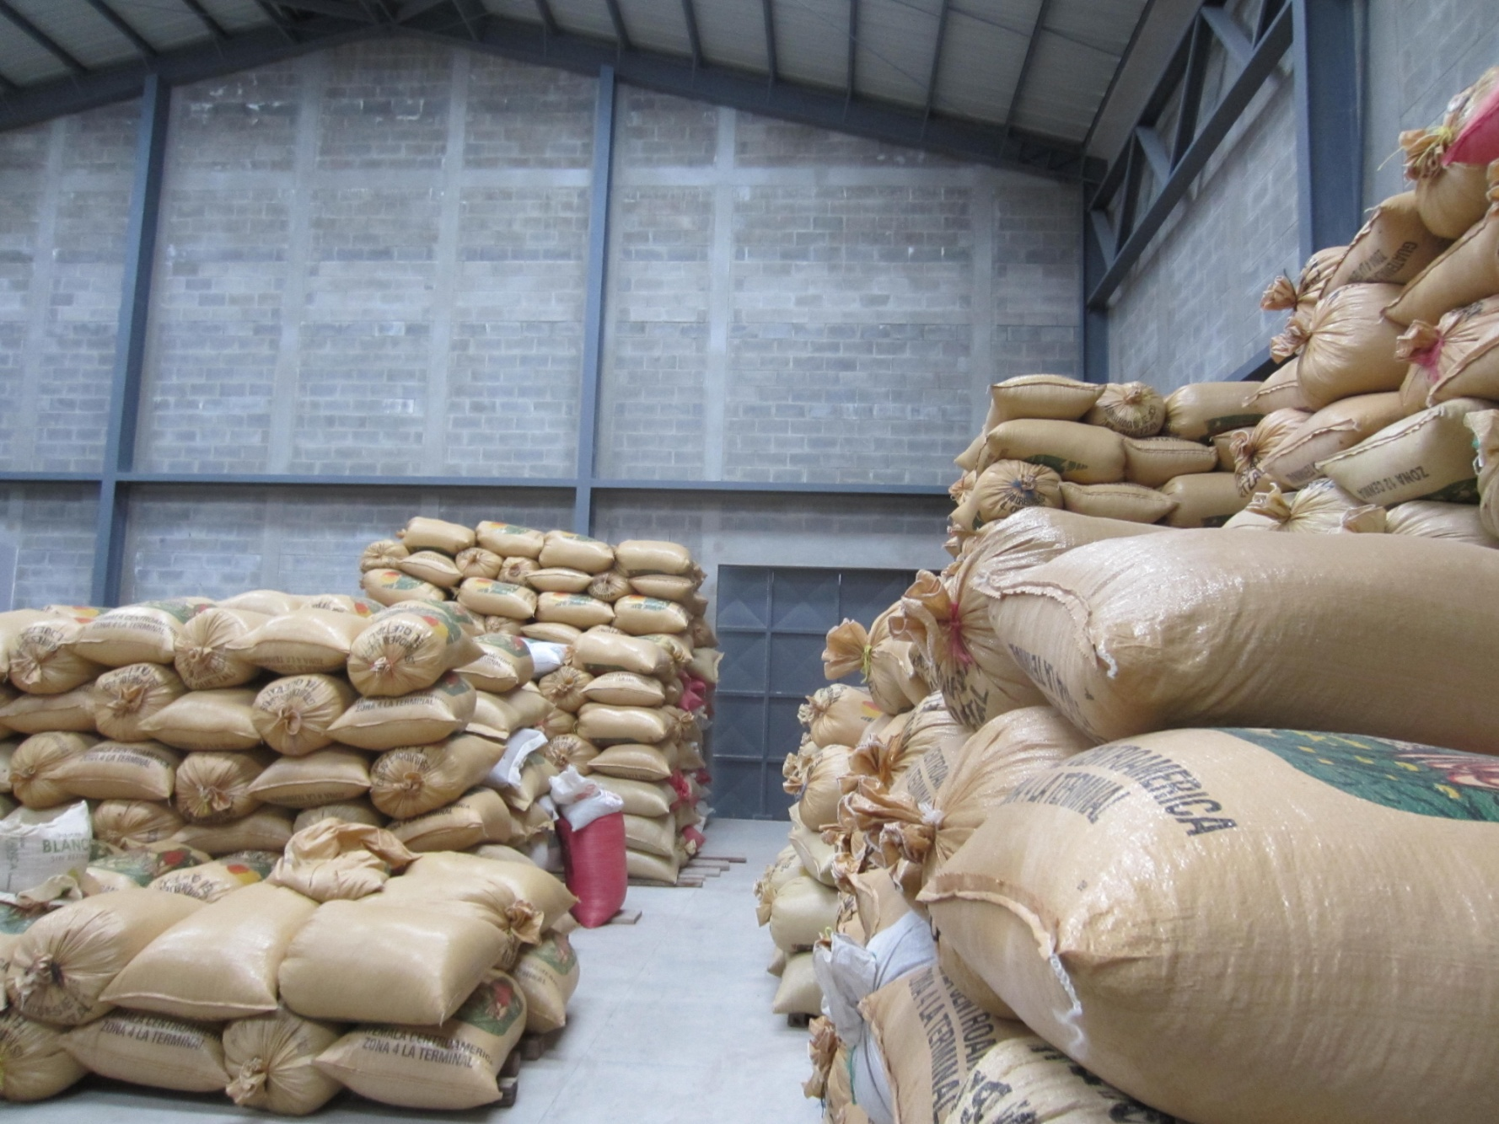
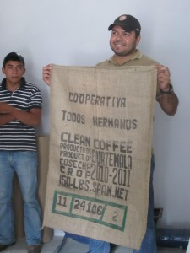
Coffee for Export
Above left: The cooperative has space to store the farmers’ processed coffee until it is ready for export
Above right: The cooperative manager holding a coffee bag from the co-op's first export last year
To date the cooperative has partnered with Green Mountain Coffee
Amount exported last year: 1 Container

